Slide 1
© 2016 Blackboard Inc.
All rights reserved.

Slide 2
Objectives
Describe the different tools that can be used to keep students informed.
Announcements
Email
Course Messages
Syllabus
Calendar
Contacts
Tasks

Slide 3
Contact Info
Add here or delete slide
Add here

Slide 4
BENEFITS OF Communication
Communication tools in online courses keep students motivated and engaged.
Students benefit by sharing new opinions.
Promote student success.
Use a variety of tools to interact asynchronously.

Slide 5
How will you keep students informed?
While exploring, try to identify the tools you will use to:
Notify students of important dates or reminders.
Know when they have completed course milestones.
How to get help if they have a questions.
Best methods of contact.

Slide 6
Announcements
Post timely information critical to course success.
Due dates for assignments and projects.
Changes to your syllabus.
Corrections/clarifications of materials.
Exam schedules/reminders.
Default module: Announcements are typically one of the first things a student sees when accessing the course.

Slide 7
FREQUENTLY ASKED QUESTIONS
What are the benefits of using Announcements instead of email?

Slide 8
TRY IT
Use your Practice Course to experiment with creating announcements.

Slide 9
email
Send email messages to other course members’ external email addresses.
You can only send email to members of the course.
All records of email will exist in your external email account.
There must be a subject line to send the message.

Slide 10
Course message
Send secure electronic messages to other course members’ within the course.
Does not use an external email address.
Both incoming and outgoing messages are saved.
If used, encourage routine checks for new messages.

Slide 11
FREQUENTLY ASKED QUESTIONS
What is the main difference between Email and Course Messages?
What are the benefits of using Email or Course Messages?

Slide 12
TRY IT
Use your Practice Course to experiment sending Email and Course Messages.

Slide 13
syllabus
Important reference that students routinely consult throughout the course.
Two methods:
Upload a Syllabus File.
Build a Syllabus File.

Slide 14
Upload a syllabus file
Benefits
Reduces vertical scrolling as it takes less space in the course area.
Students can easily save the file on their computer.
Most faculty already have a syllabus file created.

Slide 15
Use the syllabus builder
Benefits
Creates a syllabus in a modular format.
Provides three default sections: Description, Learning Objectives, and Required Materials.
More sections can be added.

Slide 16
TRY IT
Use your Practice Course to experiment with both syllabus methods and see which one you will likely use!

Slide 17
calendar
Provide students with dates for important events.
By default, the following calendars are visible:
Institution: school-wide calendar events. Created by Blackboard Administrators.
Course: course related evented. Created by instructors of the course.
Personal: events created and viewable by an individual user.

Slide 18
Calendar User Customizations
Choice of Gregorian, Hijri, or both combined format
Individual choice over "first" day of the week
Advanced filtering choices

Slide 19
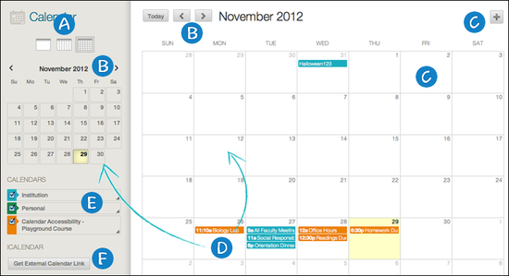
Calendar Interface
Notes:
View events by day, week, or month. Click icons to change view.
Navigate to another month.
Create a New Event by clicking on the plus sign or a date. You can then customize the event by providing a title, calendar to display the event, date/time, and description.
Color-coded display of an event. Need to modify the date? Press and drag to another date OR click the event to manage it (if you have permission).
Calendar legend. Visible calendars will have a checkmark to the left of the calendar name. To modify the color, click the arrow on the right of the name,
Link your Blackboard Learn calendar to an external calendar application. Once linked, it will automatically update when any new event is added or items are modified. NOTE: You cannot import external calendar into this calendar.

Slide 20
TRY IT
Use your Practice Course to experiment with the calendar. Create a new course event, then try editing it.

Slide 21
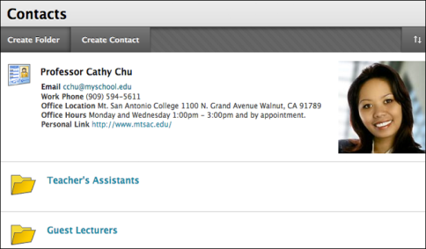
contacts
Create profiles of the instructors, teaching assistants, and guest lectures from a single location.

Slide 22
FREQUENTLY ASKED QUESTIONS
Why use Contacts if I have this information in my Syllabus?

Slide 23
TRY IT
Use your Practice Course to create a new contact profile.

Slide 24
Tasks
Designed to keep students on track.
Identify course milestones into tasks.
New tasks will need:
Task Name
Description
Due Date
Priority

Slide 25
TRY IT
Use your Practice Course to create new task.

Slide 26
Spotlight on communication
Which course tools will you use?
Which course communication tools will you use?

Slide 27
WRAP UP
To learn more, visit help.blackboard.com.

